Slide 1
Requesting Reasonable Accommodations and Modifications at KCDC Properties:
A Public Service Announcement for Those with Disabilities

Slide 2
Home is where you should be most comfortable

Slide 3
And if you have a disability, you have the right to make your home accessible and request reasonable accommodations or modifications.
Notes:
People with disabilities have the same housing rights as other tenants. You cannot be denied access to rental housing just because of a disability.. And you can't be charged extra just because of your disability.

Slide 4
REASONABLE ACCOMMODATION Change in Rules or Procedures
Notes:
Tenants with disabilities have the right to ask landlords to change rules and procedures in order to ensure their housing is accessible. These are called reasonable accommodations.

Slide 5
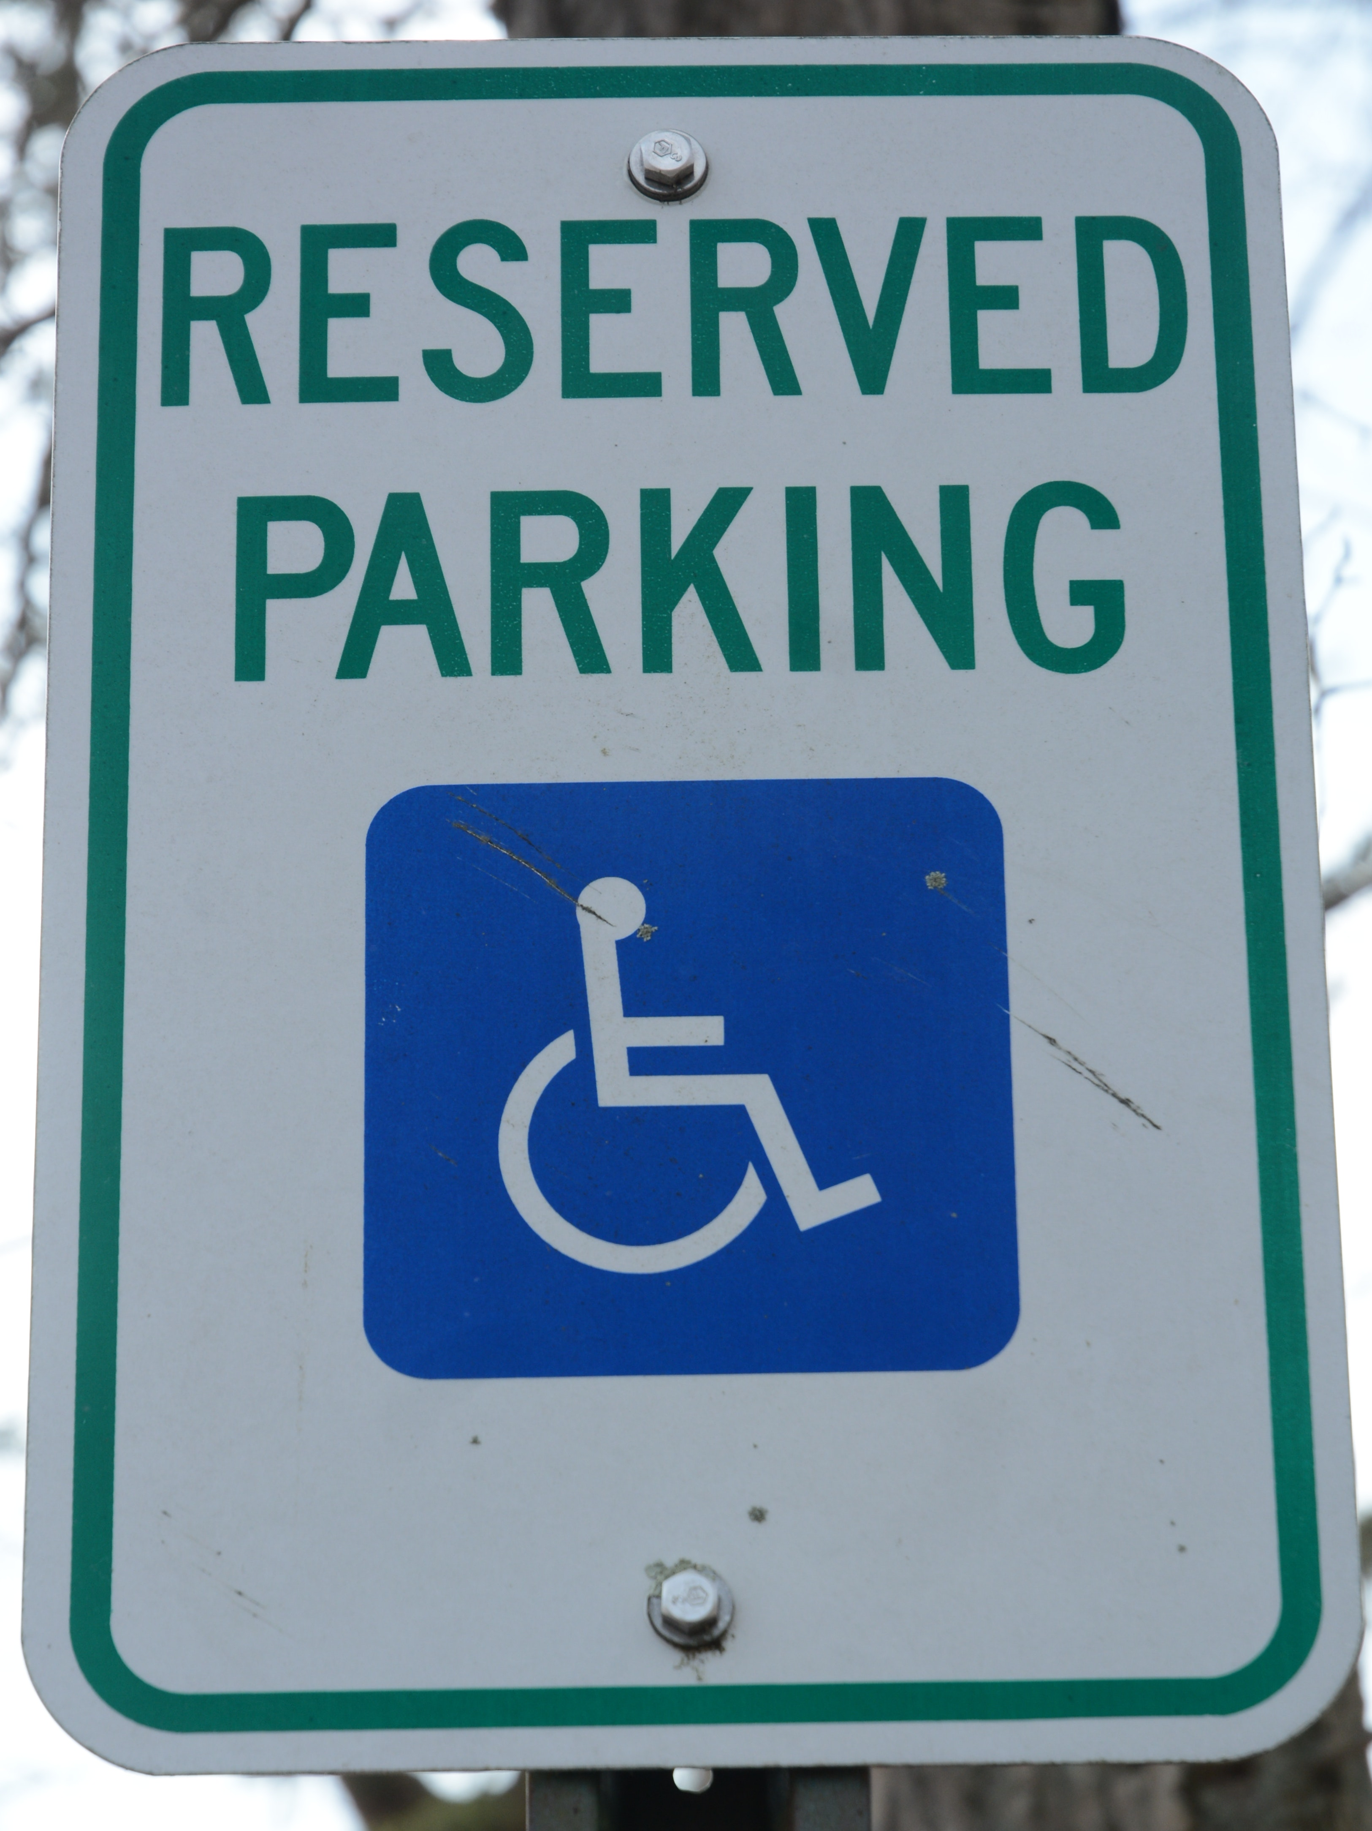
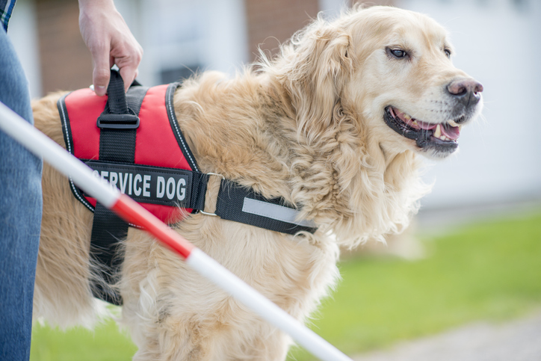
Notes:
You might ask your landlord to give you an assigned parking space closer to your apartment. Allow you to use a mailbox at a lower level where you can reach it more easily. Allow you to mail in your rent check rather than making you pay rent in person. Permit you to have a service or emotional support animal

Slide 6
REASONABLE MODIFICATION A change that makes your home more accessible
Notes:
people with disabilities need to be able to fully move around and make use of their homes.

Slide 7
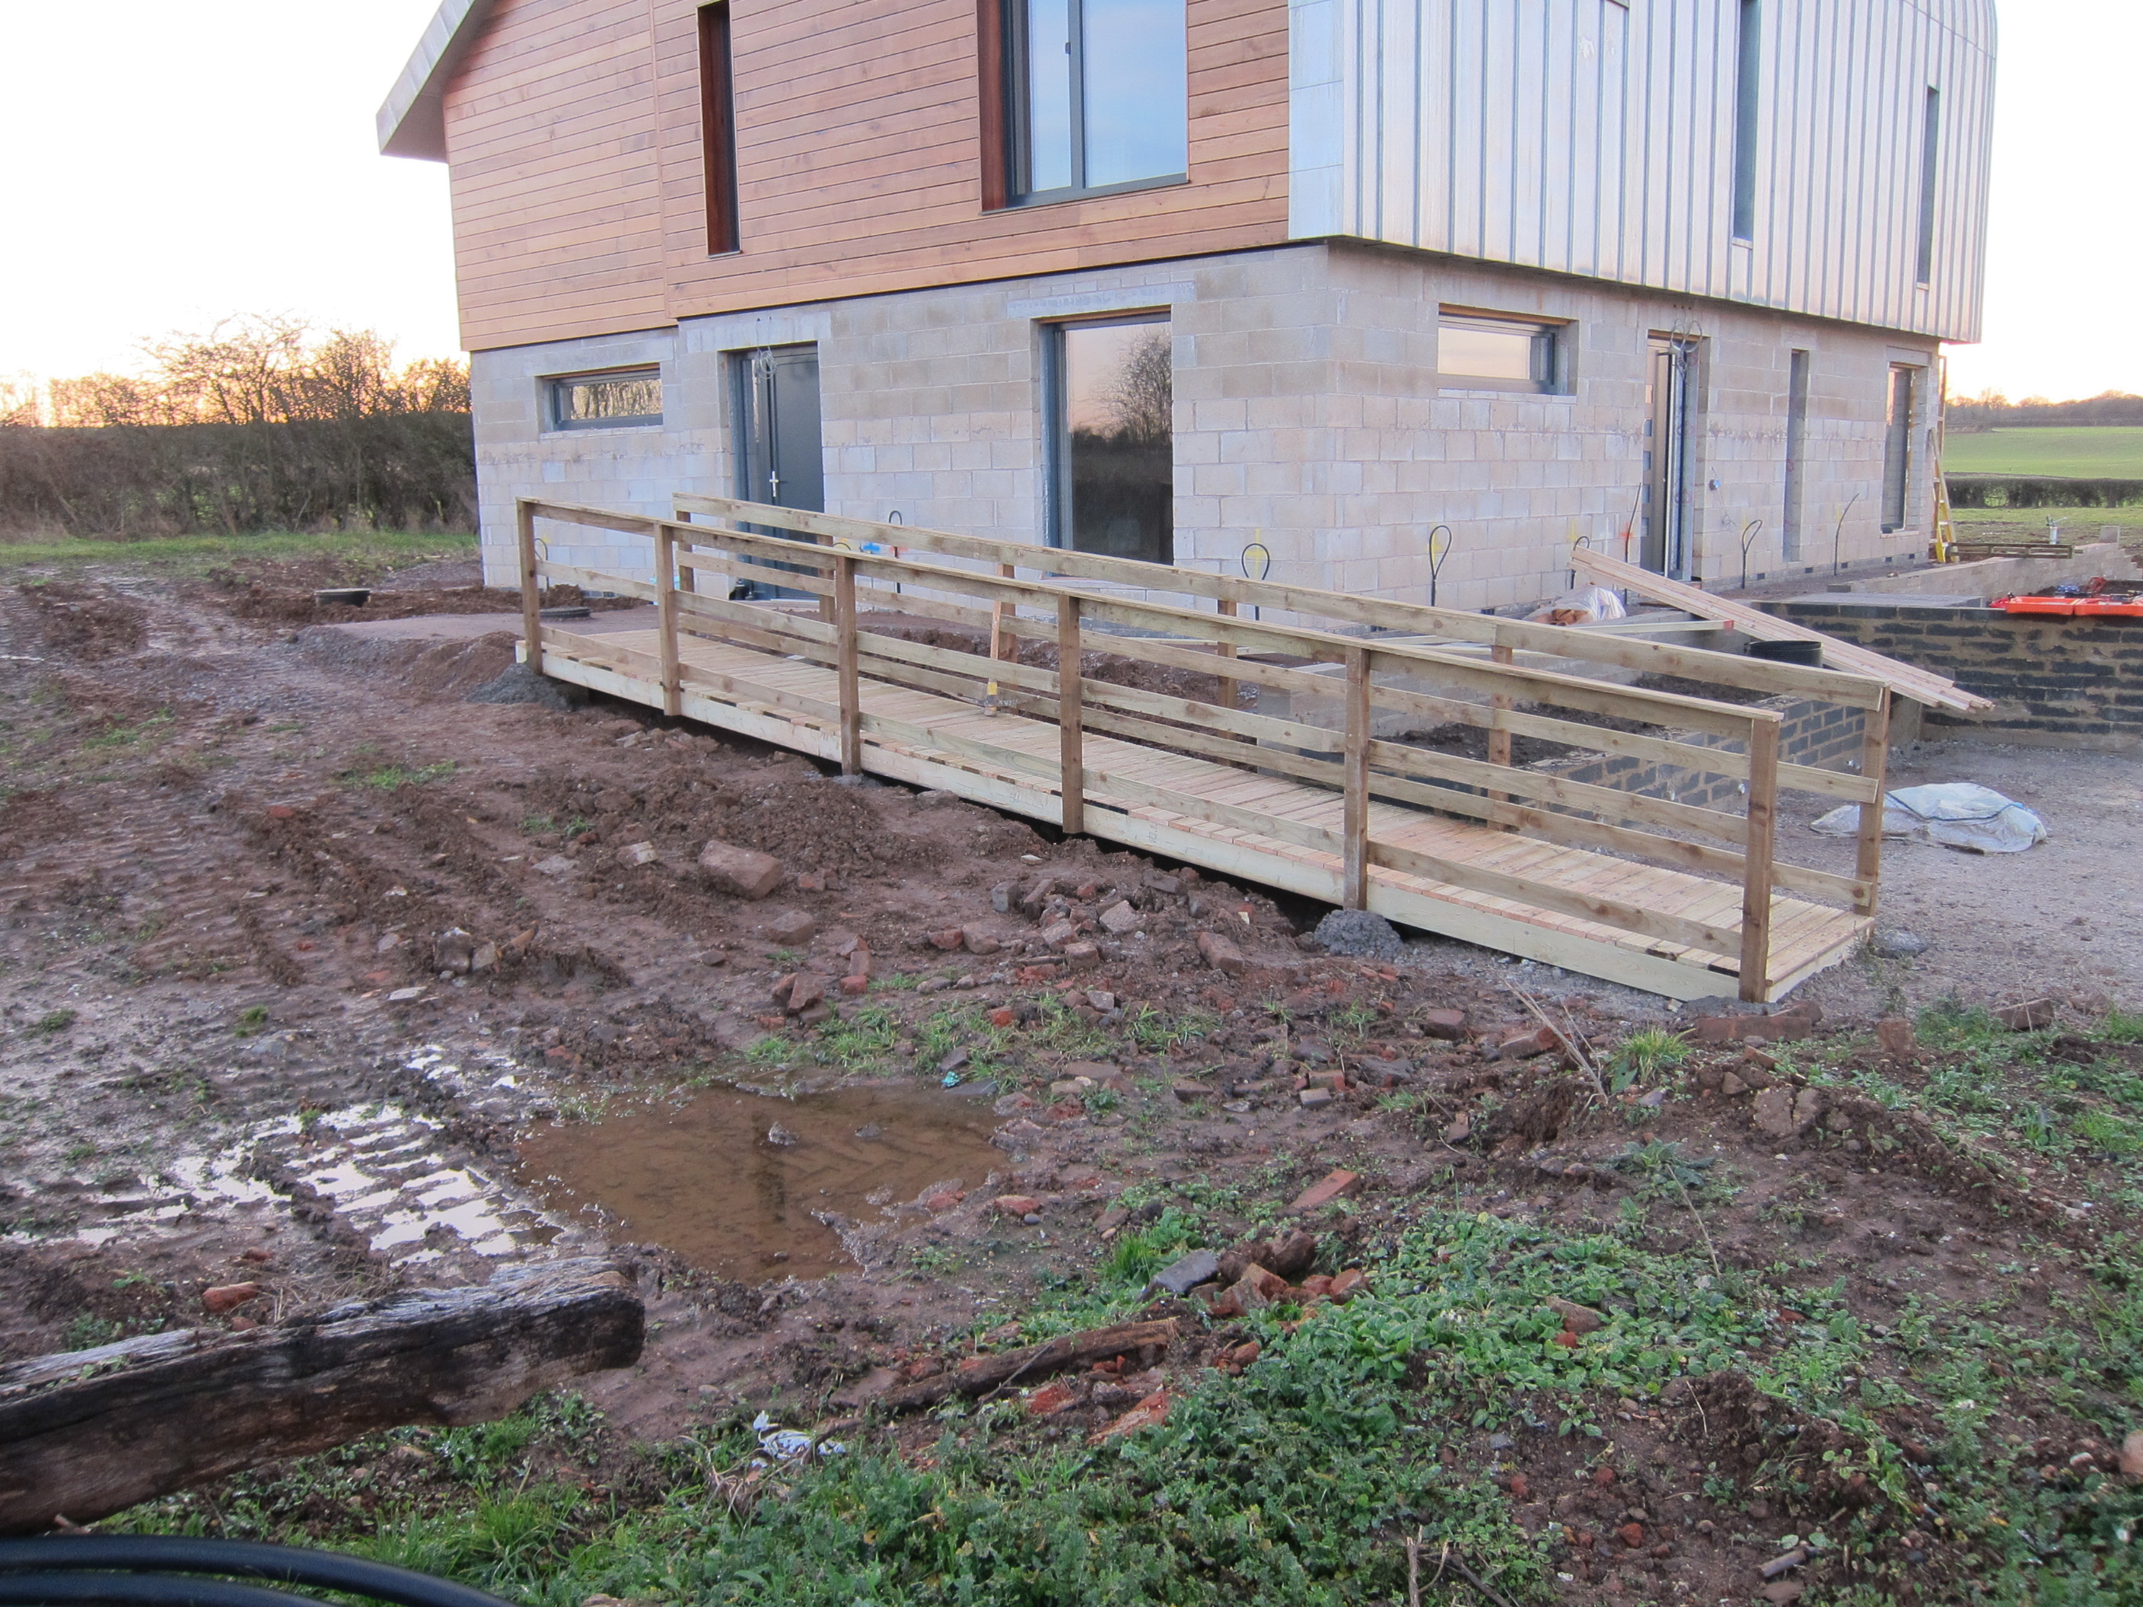
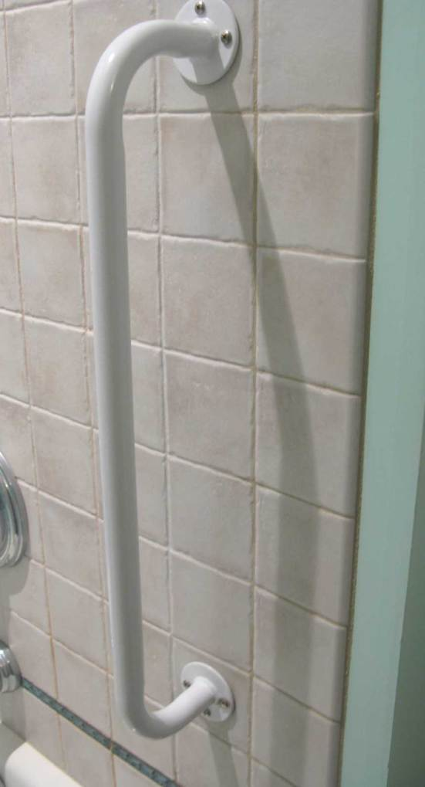
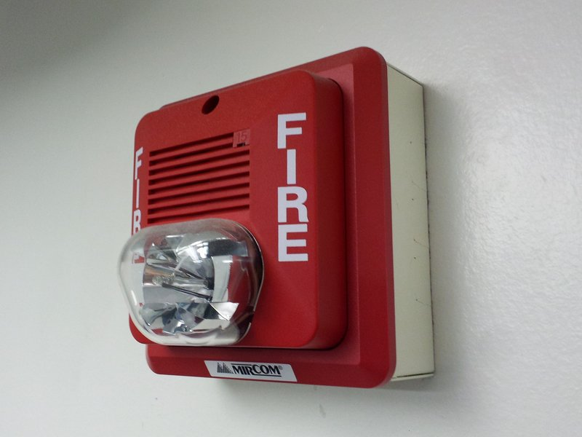
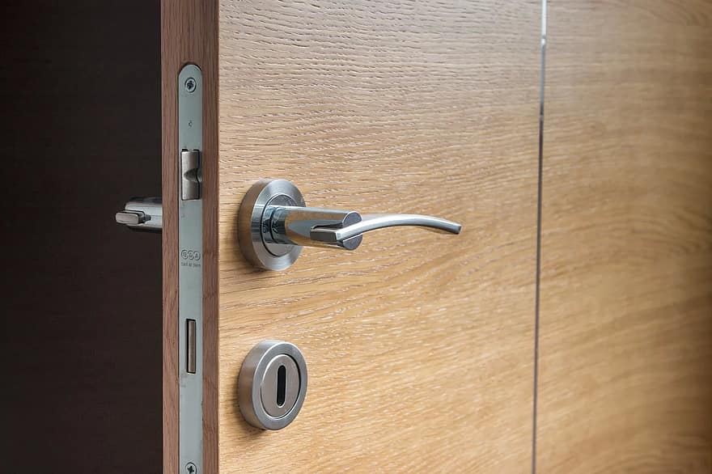
This Photo by Unknown Author is licensed under CC BY-SA
Notes:
Modifications may include items such as installing a grab bar in your bathroom. Providing a ramp. Changing hardware on a door. Installing audio or visual alarm systems for deaf or hearing impaired tenants.

Slide 8
Notes:
If you're worried about asking your landlord for accommodations or modifications, don’t be. It is not legal for your landlord to punish or evict you simply because you asked for reasonable accommodations or modifications. Landlords like KCDC are educated about and prepared to discuss these types of needs with you.

Slide 9
THANK YOU!
To read KCDC’s Notice of Reasonable Accommodation or to Fill Out a Written Request for Accommodation or Modification, click the following link: www.kcdc.org
If you need assistance with filing a request, please call our 504 Coordinator Kimberly Mills
at 865-403-1100 x. 1195
Notes:
Remember, people with disabilities who rent housing have the same right as any other tenant to live comfortably in their home.

